Slide 1
Exploratory Testing
Software Testing

Slide 2
EXPLORATORY TESTING
It is a type of software testing where Test cases are not created in advance but testers check system on the fly. They may note down ideas about what to test before test execution. The focus of exploratory testing is more on testing as a "thinking" activity.
Exploratory Testing is widely used in Agile models and is all about discovery, investigation, and learning. It emphasizes personal freedom and responsibility of the individual tester.
Exploratory testing is a hands-on approach in which testers are involved in minimum planning and maximum test execution.

Slide 3
Continued..
The test design and test execution activities are performed in parallel typically without formally documenting the test conditions, test cases or test scripts. This does not mean that other, more formal testing techniques will not be used. For example, the tester may decide to us boundary value analysis but will think through and test the most important boundary values without necessarily writing them down. Some notes will be written during the exploratory-testing session, so that a report can be produced afterwards.
Scripted Test Execution is usually a non-thinking activity where testers execute the test steps and compare the actual results with expected results. Such test execution activity can be automated does not require many cognitive skills.

Slide 4
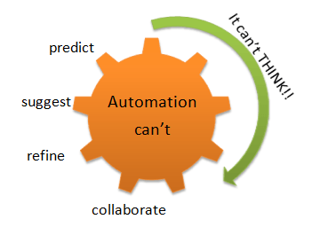
Though the current trend in software testing is to push for automation, exploratory testing is a new way of thinking. Automation has its limits

Slide 5
Exploratory testing
Is not random testing but it is ad-hoc testing with a purpose of find bugs
Is structured and rigorous
Is cognitively (thinking) structured as compared to the procedural structure of scripted testing. This structure comes from Charter, time boxing etc.
Is highly teachable and manageable
It is not a technique but it is an approach. What actions you perform next is governed by what you are doing currently

Slide 6
How to do Exploratory testing
Create a Bug Taxonomy (classification)
Categorize common types of faults found in the past projects
Analyze the root cause analysis of the problems or faults
Find the risks and develop ideas to test the application.
Test Charter
Test Charter should suggest
what to test
how it can be tested
What needs to be looked
Test ideas are the starting point of exploration testing
Test charter helps determine how the end user could use the system

Slide 7
How to do Exploratory testing
3. Time Box
This method includes a pair of testers working together not less than 90 minutes
There should not be any interrupted time in those 90 minutes session
Timebox can be extended or reduced by 45 minutes
This session encourages testers to react on the response from the system and prepare for the correct outcome
4. Review Results:
Evaluation of the defects
Learning from the testing
Analysis of coverage areas
5. Debriefing:
Compilation of the output results
Compare the results with the charter
Check whether any additional testing is needed

Slide 8
When to do Exploratory Testing
In the early stages of SDLC – software development life cycle when the code undergoes rapid changes, exploratory testing can be highly effective.
The developers can use this technique to perform unit tests while the testers can acquire familiarity with the application using this testing approach.
The experience gained from exploratory testing can be valuable in preparing test scripts and doing additional testing in the later stages of the software development life cycle.
In the agile development environment, there are short scrum cycles and little time available for developing formal test design and scripts. Exploratory testing is well suited for agile environment as it keeps up with the short scrum cycles.
While performing exploratory testing, test plans are developed on the fly which saves lot of time for the tester. At the end of each scrum cycle, critical exploratory tests can be captured for subsequent scrums.

Slide 9
Advantages
Less preparation is needed and important bugs are found quickly
Thinking on your feet, reacting quickly is encouraged and more defects are uncovered
Lot of focus is given to expanding your knowledge and learning, for the tester
It can be used to review the work done by another tester
Exploratory testing can catch defects that may have been missed in the test cases
In case of limited time, exploratory testing can be used to test new features while regression testing can be used for existing features

Slide 10
Disadvantages
As the tests are invented and performed randomly, they can’t be reviewed in advance, and it can be difficult to show which tests have to be run.
Testing is dependent on tester’s knowledge, skill and experience.
Gaining familiarity with an application takes time, so there is a possibility of defects being missed if the tester has less knowledge of the website or application

Slide 11
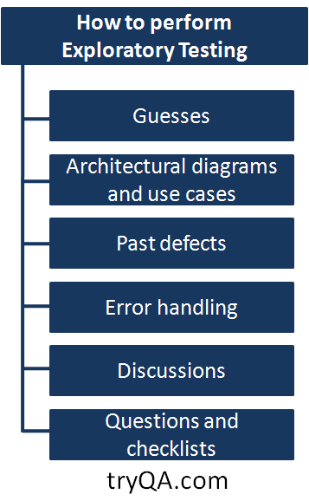
Let us assume you have been asked to perform exploratory testing on a Hospital management system.
As shown in the figure below, there are several ways to perform exploratory testing.

Slide 12
1. Guesses
Guesses are used to find part of the program that is likely to have more errors. Previous experience of working on a similar product / software / technology helps in guessing.
In case of the Hospital management system, you could guess that the payment module can have higher errors since it has to integrate with the payment gateway, transactions could time out and lead to errors if not handled correctly.

Slide 13
2.Architectural diagrams and use cases
Architectural diagrams describe the interactions and relationships between different components and modules. Use cases give an understanding of the product’s usage from the end user’s perspective.
Exploration technique may use these diagrams and use cases to test the product.
Hospital Administration System – You remember that there was a use case where more than one person could share the same phone number and the application should accept it, you decide to test that scenario.

Slide 14
3.Past Defects
Studying the defects reported in the previous releases helps in understanding those features of the software that are expected to have maximum defects.
In the past, reporting module of the hospital management system used to consume a lot of memory and have several errors so you decide to test it as well.

Slide 15
Error Handling
Error handling is that part of the code which takes appropriate actions in case of any failure. Exploratory testing could be done using different scenarios to test graceful error handling.
In the Hospital Management System, the reporting module would consume a lot of memory and crash sometimes. You decide to test it to ensure that reports that have been queued for generation are generated eventually even if there are any issues encountered in between.

Slide 16
4. Discussions
Exploratory testing could also be planned based on the understanding of the software during project discussions and meetings.
5. Questions and checklists
Questions like “what, when, how, who and why” can provide clues for exploratory testing of the software.

Slide 17
Categories of Exploratory Testing
1. Freestyle exploratory testing
In freestyle exploratory testing, application is tested in adhoc way and not many guidelines or procedures are set for testing. But exploratory testing can be useful in the following situations:
The tester needs to get familiarized with the application rapidly
The tester has to validate other tester’s work
A defect is required to be examined by the tester

Slide 18
Categories of Exploratory Testing
3. Strategy based exploratory testing
In strategy based exploratory testing, common testing techniques like Decision Table based testing, Cause-Effect graphing, and Error Guessing are joined with the exploratory testing. The suitable tester for this type of testing would be someone who has good knowledge about the application.

Slide 19
Categories of Exploratory Testing
2. Scenario based exploratory testing
In Scenario based exploratory testing, testing is performed on the basis of scenarios. Scenarios could be provided by the customer or could be prepared by the test team. After preliminary testing has been performed, testers may innovate testing based on gained knowledge and skill.

Slide 20
Exploratory Testing in Agile
In Agile methodology there are short sprints usually of about one month and the deadlines are extremely tight. Exploratory testing is very useful in agile because of tight deadlines and focus on speedy results. Once the requirements are understood by the tester, he can perform testing on the basis of his/her skill and intuition.
When the tester becomes more familiar with the application’s features and behaviour, he can create additional test cases for further testing and could find more bugs.
As exploratory testing in agile is free of rigid processes and documentation requirements, the tester does not have to maintain documents for everything but it would be good if a short report on items tested, bugs found etc. is maintained for the purpose of future reference.

Slide 21
L(3^3 2^1)
L(3^4)
L(5^2 4^2 2^1)
v1 4
v2 5
V3 5
V4 2
V5 4

